Slide 1
al-Farabi Kazakh National University
Organization and Planning of Scientific Research
Lecture 10
Working with Scopus: Searching, Selecting, and Evaluating Scientific Articles
Bektemessov Zholaman
Almaty
2025

Slide 2
Searching for Scientific Information in Scopus
Goal: to develop skills in searching publications, analyzing sources, and working with author profiles.
What is Scopus – an instrument for scientific research and academic writing.
• The largest international scientometric database
• Contains journal articles, reviews, conference proceedings, textbook chapters, and monographs
• Used for scientific research, literature search, citation analysis, and journal selection

Slide 3
Registration and access via
Elsevier Kazakhstan
1. Go to https://www.scopus.com
2. Click “Register” and create an account using your institutional email
3. While connected to the university network (Wi-Fi or LAN), sign in
4. Access will be activated automatically via institutional access
5. If accessing from off-campus: log in through the university library (Remote access)

Slide 4
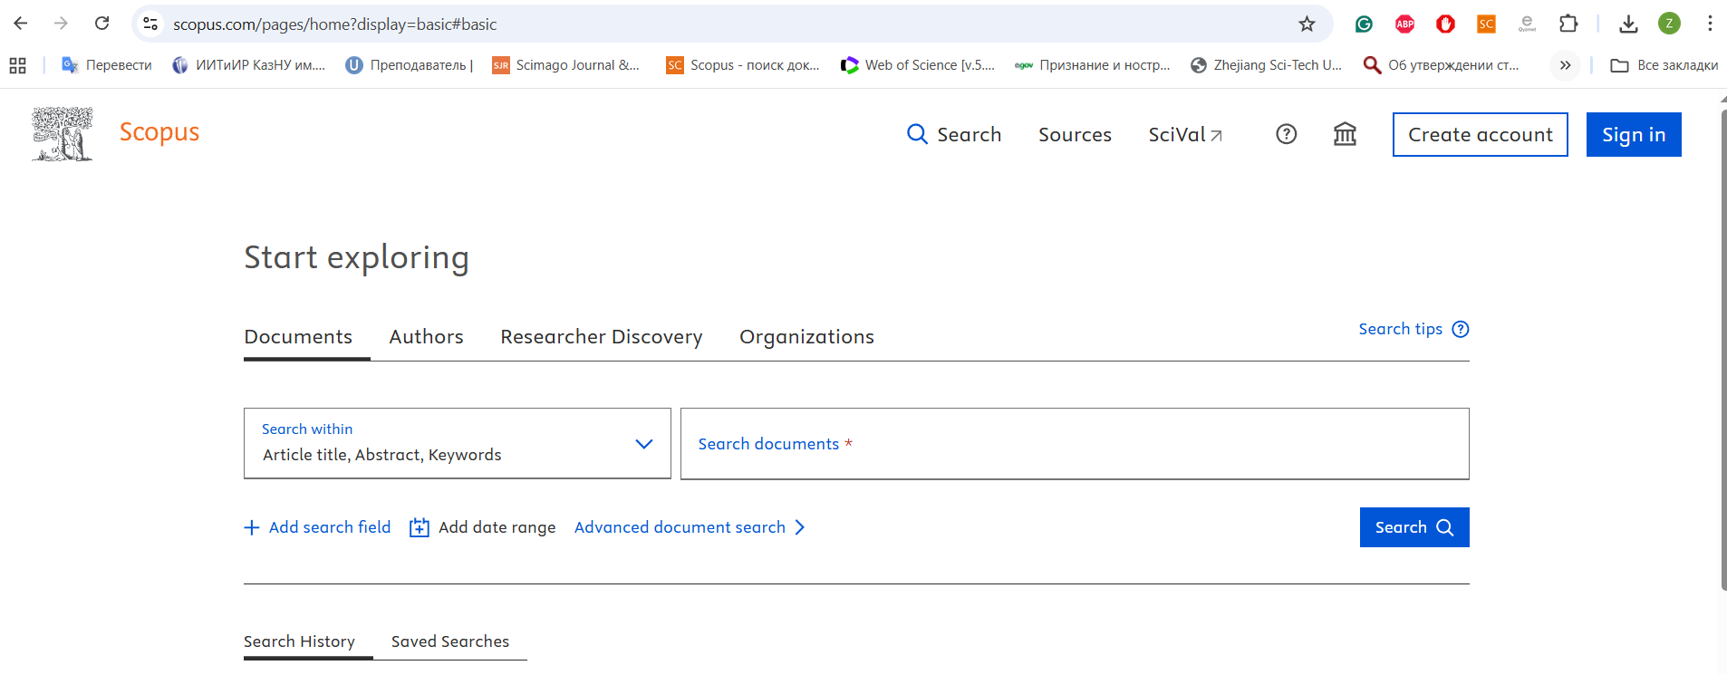
Account creation

Slide 5
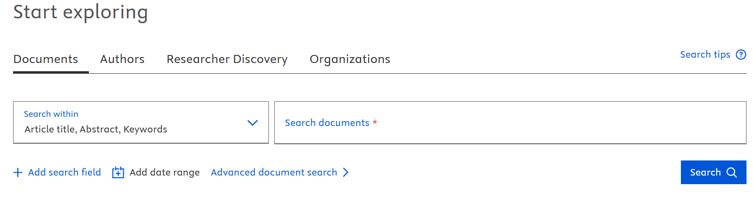
Scopus interface: search
Sections:
• Documents - search for publications
• Authors - search for authors
• Research Discovery - a “smart feed” of new articles based on your research interests
• Organizations - search for institutions

Slide 6
Basic Search
• Article title, Abstract or Keywords
• Operators: AND, OR, NOT
• Example: cancer AND immunotherapy

Slide 7
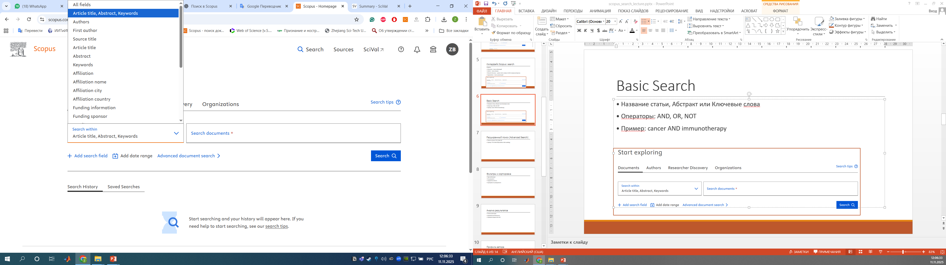
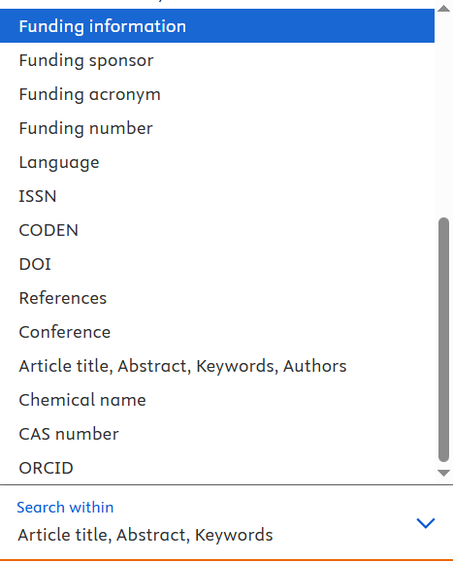
Different fields search

Slide 8
Filtering
• Publication years: you can set a range or select a specific year
• Author: you may choose one author or a group of authors
• Document type: article, review, note, letter, book chapter, etc.
• Source title
• Keyword
• Affiliation (organization)
• Funding sponsor
• Author’s country/territory
• Language of publication
• Access type: all open access, green, gold, hybrid, etc.
Note:
You can both include and exclude items using the filters.

Slide 9
Ordering
• By date: from newest to oldest, or vice versa
• By citations: from highest to lowest, or vice versa
• By relevance
• By alphabetical order of the first author
• By alphabetical order of the source title

Slide 10
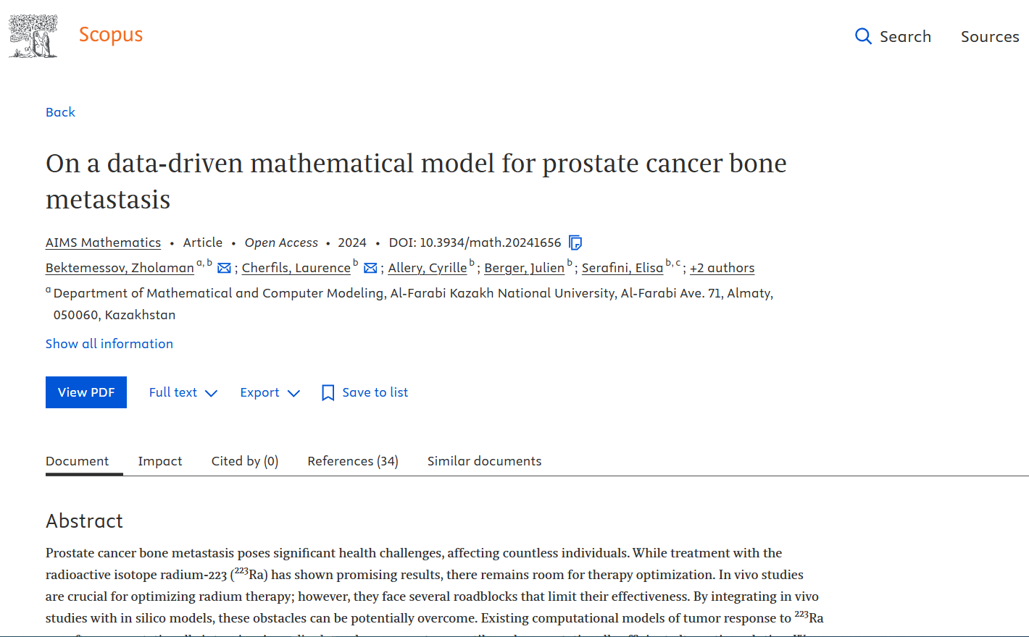
Result analysis
• Read the abstract
• Evaluate the relevance

Slide 11
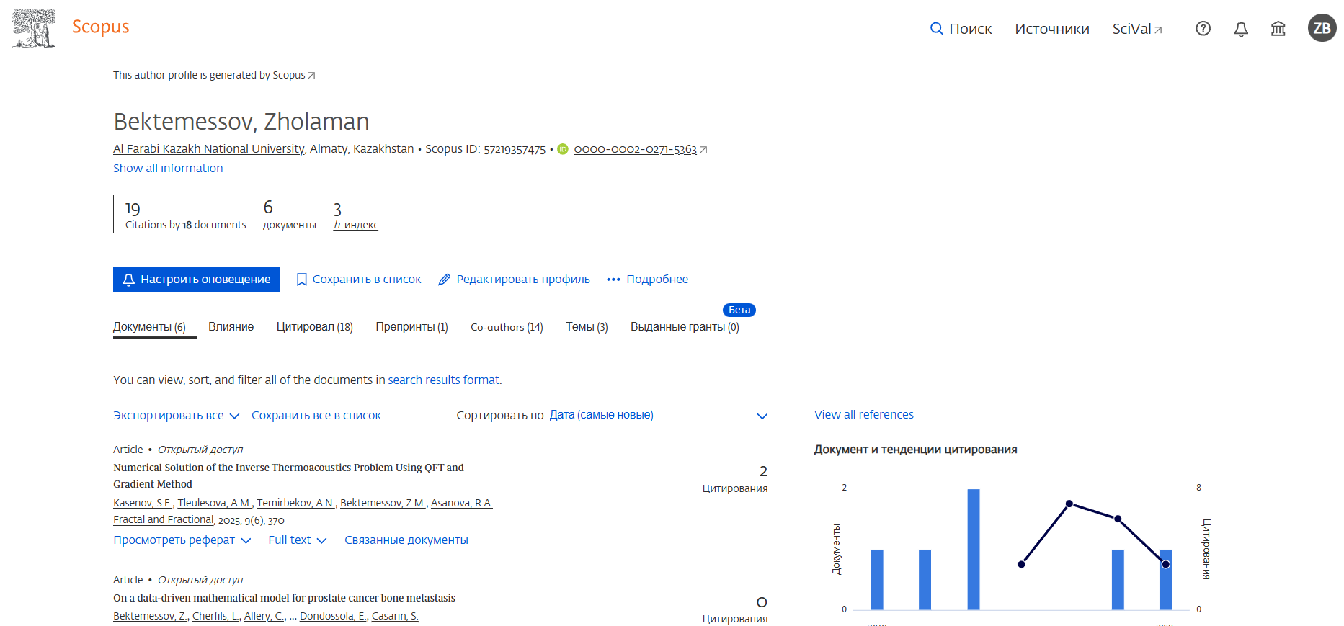
Author’s profile
• h-index
• Sum of citations
• Scopus ID

Slide 12
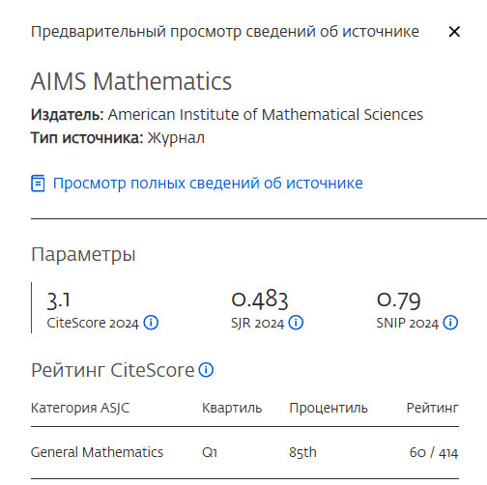
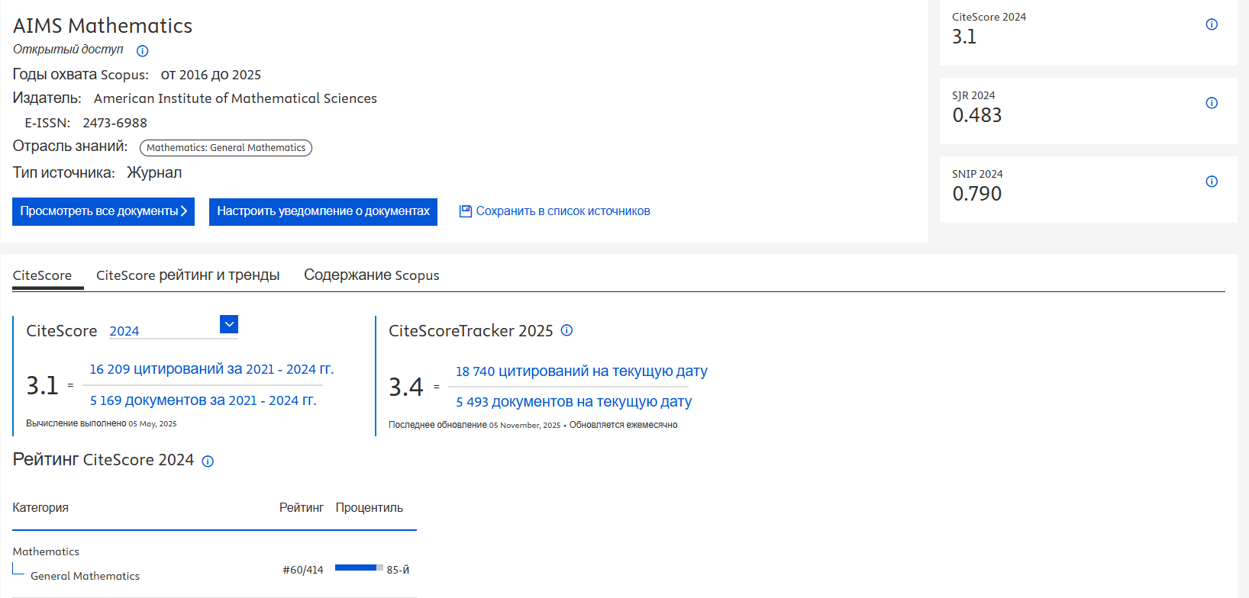
Source’s profile
• Metrics: SJR, CiteScore
• Choosing the source for publishing
• Quartile
• Procentile
• Content

Slide 13
Typical mistakes
• Overly broad search queries
• Ignoring filters
• Relying only on quantitative indicators

Slide 14
Thank you for your attention!

